Slide 1

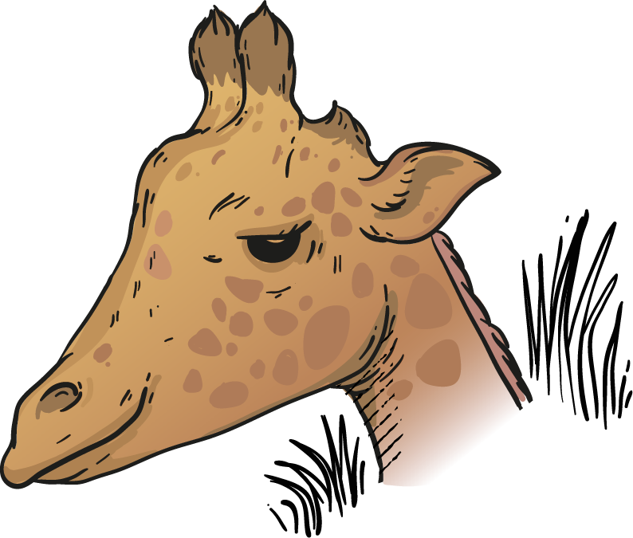

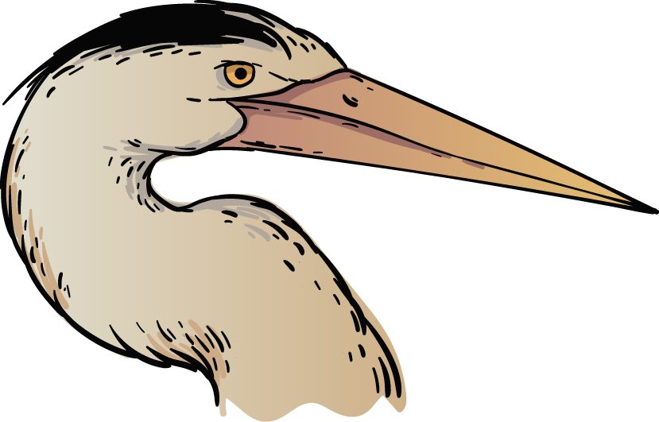


Better Visuals, Better Voices for Animals
Team 10: Tony Afuti, Luke Henkel,
Vanessa Hernandez & Brendon Matsikinya

Slide 2
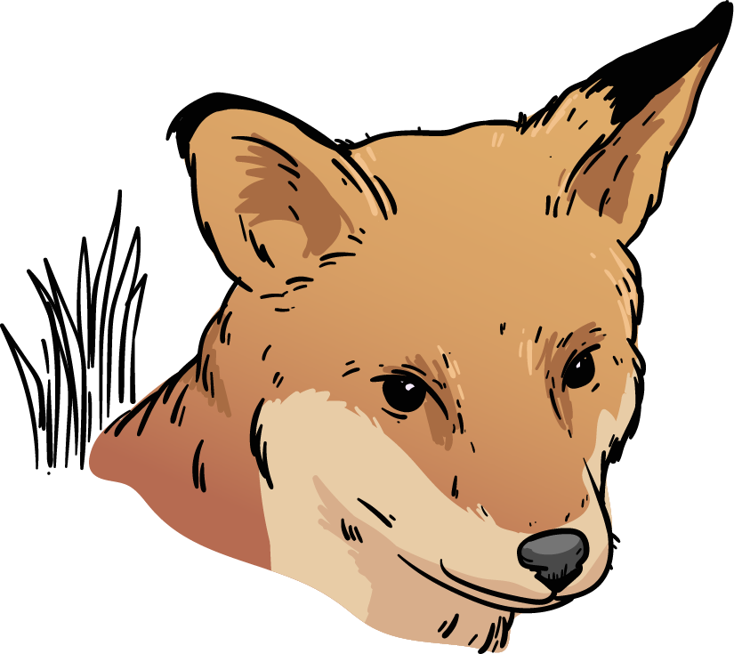
Why this topic?
Animal Rights around the World – Zsofia Nika
Understanding the global animal welfare and ethical practices
Examining the impact of meat consumption, animal suffering, and fur trade
Improving the clarity and storytelling of the original viz
Notes:
We are going with a project on "Animal Rights around the World," which is about exactly that. Link is: https://public.tableau.com/app/profile/zsofia.nika/viz/AnimalRights_17092289911360/AnimalRights
We thought that this was an important topic with a lot of good data to represent, and that this visualization does some things well, but has a lot to improve. For example, the use of the arbitrarily placed dots is super confusing. It makes it clear how everyone is doing with each metric, but that's less important than how each country is doing with all the metrics (in our opinion). We like the colorblind-friendly colors, but finding a specific country is next to impossible and once you find it, it's difficult still to assess how they're doing with animal rights altogether.
We will be going with a "dashboard" theme, similar to the original visualization but ours will be better, potentially incorporating a map and certainly a few easier charts to look at. We like the dashboard idea since there's a few different visuals that would be relevant to telling this whole story, not just one map or graph.

Slide 3
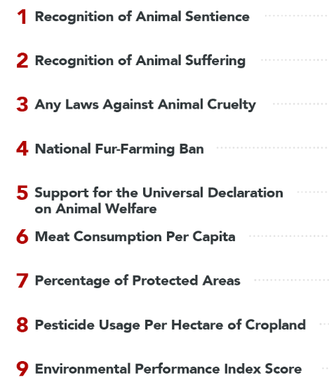

Our Data Source
Our Source Pulls From:
PETA (People for the Ethical Treatment of Animals)
World Animal Protection
Global Animal Law
Notes:
We are going with a project on "Animal Rights around the World," which is about exactly that. Link is: https://public.tableau.com/app/profile/zsofia.nika/viz/AnimalRights_17092289911360/AnimalRights
We thought that this was an important topic with a lot of good data to represent, and that this visualization does some things well, but has a lot to improve. For example, the use of the arbitrarily placed dots is super confusing. It makes it clear how everyone is doing with each metric, but that's less important than how each country is doing with all the metrics (in our opinion). We like the colorblind-friendly colors, but finding a specific country is next to impossible and once you find it, it's difficult still to assess how they're doing with animal rights altogether.
We will be going with a "dashboard" theme, similar to the original visualization but ours will be better, potentially incorporating a map and certainly a few easier charts to look at. We like the dashboard idea since there's a few different visuals that would be relevant to telling this whole story, not just one map or graph.

Slide 4
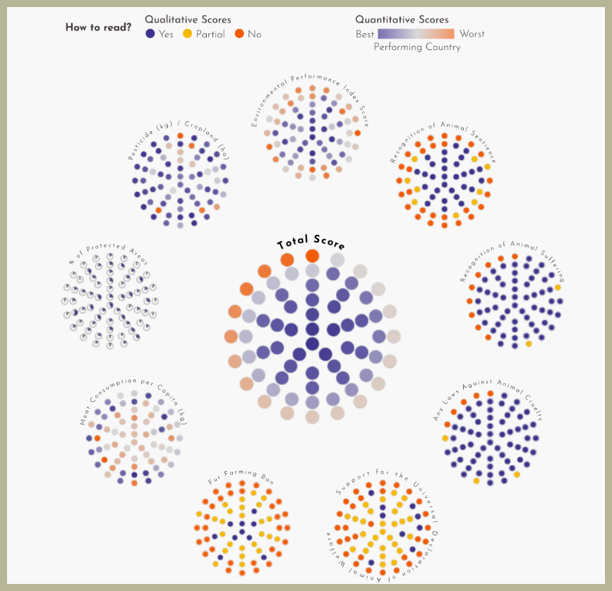
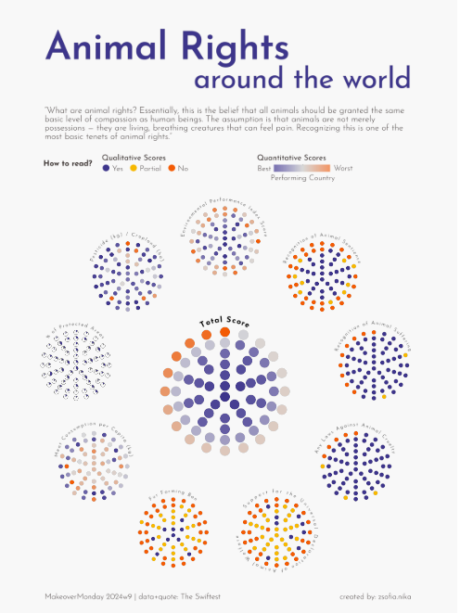
Deconstructing: What didn’t work?
Notes:
Overcrowded and hard to interpret
Difficult to compare categories like meat consumption, animal cruelty, and fur trade
Lack the 4Cs
Lack of Interactivity
For example, the use of the arbitrarily placed dots is super confusing. It makes it clear how everyone is doing with each metric, but that's less important than how each country is doing with all the metrics (in our opinion). We like the colorblind-friendly colors, but finding a specific country is next to impossible and once you find it, it's difficult still to assess how they're doing with animal rights altogether.

Slide 5
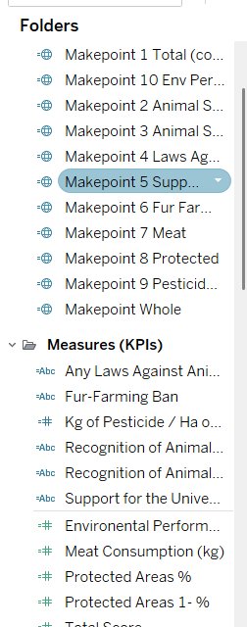
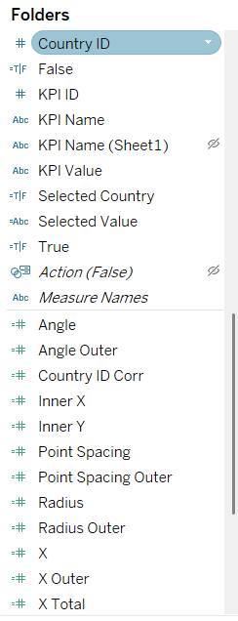
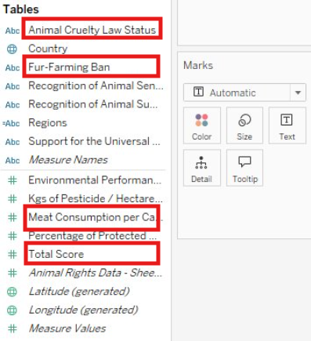
Our Reconstruction Approach
vs.

Slide 6




Our Reconstruction Approach
Treatment of Animals Overall
Animal Cruelty
Meat Consumption
Fur Trade

Slide 7
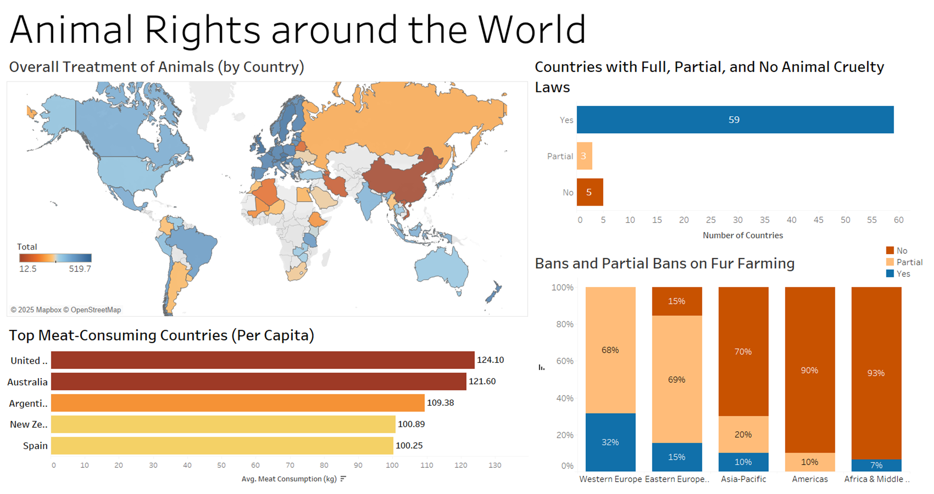
Notes:
Makes Geography much easier to interpret

Slide 8
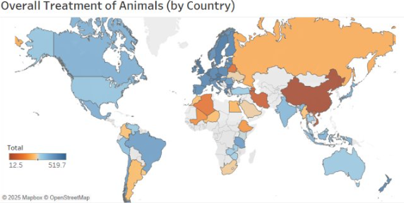

Slide 9
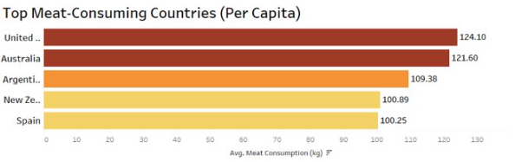

Slide 10
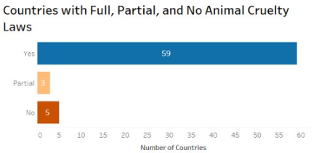

Slide 11
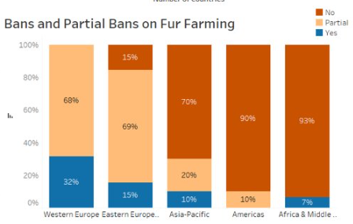

Slide 12
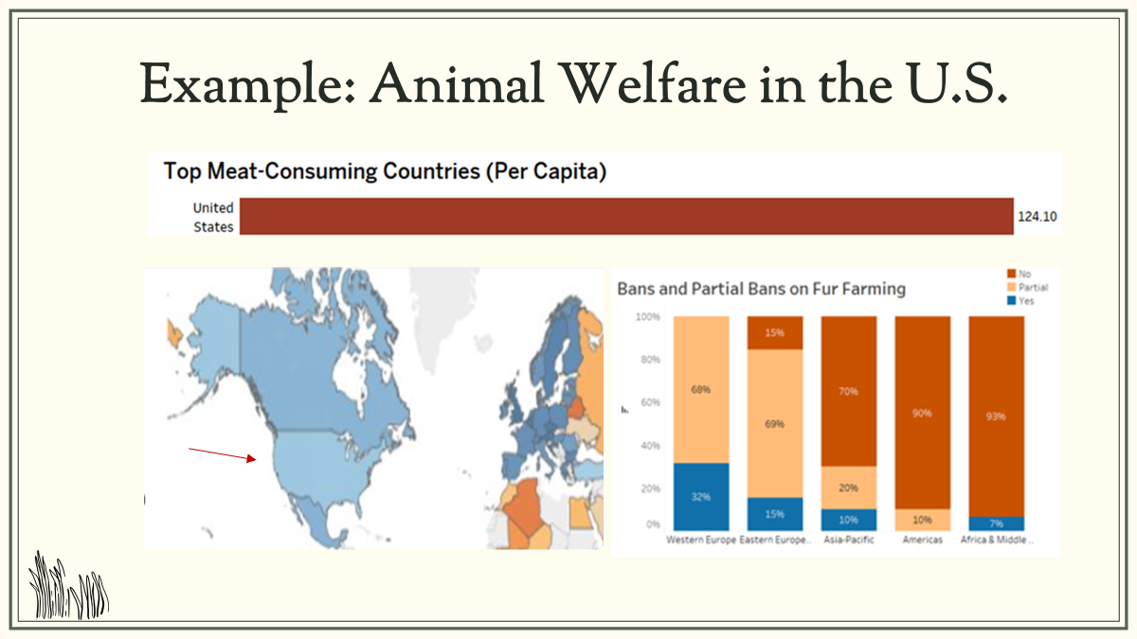
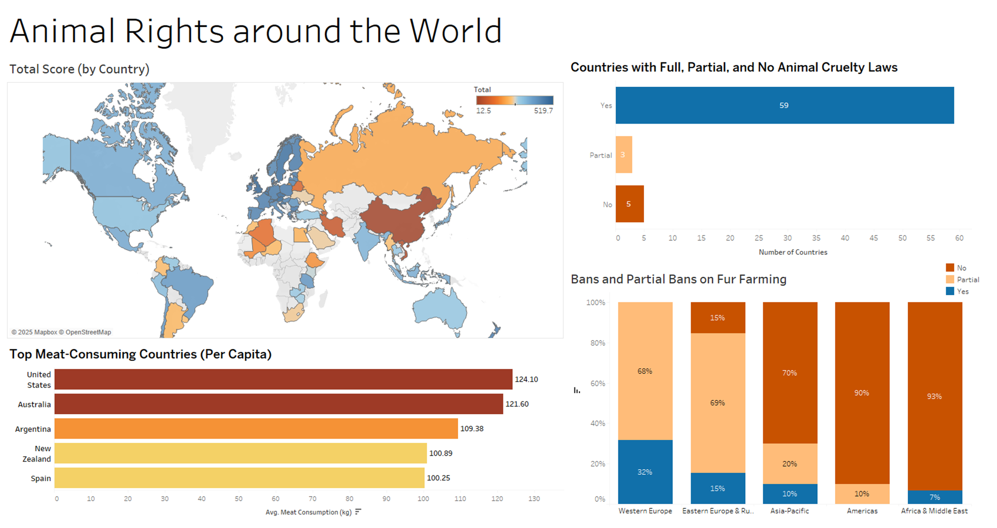
Notes:
Vanessa
Animal right index score
At the top, the bar chart shows that the U.S. has the highest meat consumption per capita globally. On the left, the regional map provides context by comparing the U.S. to neighboring countries., the us has a slightly lower scores than nearby country
To the right, we see the global landscape of fur farming policies. Notice that in the Americas, including the U.S., there are very little nationwide bans on fur farming. This contrasts sharply with Western Europe, where fur farming is heavily restricted. This clearly exposes a significant policy gap in the U.S., despite its influential role in setting cultural and economic trends.
This shows how this one country can be analyzed through our dashboard, This insight highlights an opportunity for impactful advocacy. By focusing efforts in the U.S., we can influence not only domestic policies but also global consumption trends.

Slide 13
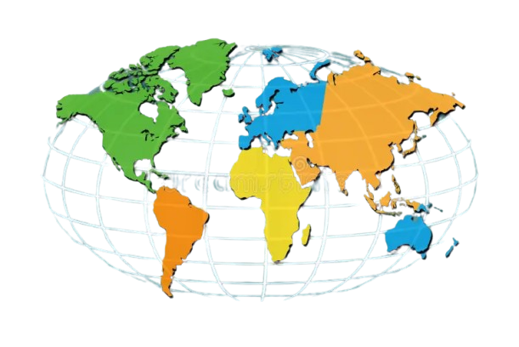
Key Insights from Reconstructed Dashboard
Animal Welfare Clarity
Policy Gaps
Trends by Region
Notes:
Vanessa
Animal welfare clarity: Clearer comparison between countries
●Our dashboard makes it easy to see where animal welfare laws are strong and where they are lacking. This transparency can empowers policymakers and advocates to focus their efforts where they are needed most and people in support of animals.
Trends by Region: Highlighting the regions fur ban
●Our dashboard revealed clear regional patterns. For example, Western Europe shows strong anima fur bans, while parts of Asia and the Americas have more inconsistent policies. By understanding these trends, we can better tailor awareness campaigns and policy initiatives.
Policy Gap: In the U.S., people eat the most meat, but the laws to protect animals are not strong enough. There are no nationwide bans on fur farming, even though many animals are used for fur. Weak or No Laws = policy gap. And animal cruelty laws
In the U.S., people eat the most meat, but the laws to protect animals are not strong enough. There are no nationwide bans on fur farming, even though many animals are used for fur.

Slide 14
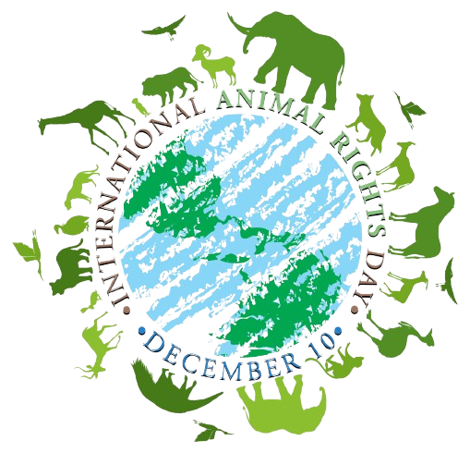
Final Takeaways
Key Findings
Global animal welfare and ethics
Impact of meat consumption and fur trade
Actionable Insights
Target high fur farming countries with awareness campaigns
Educate consumers on ethical impacts to influence decisions
Notes:
Vanessa
●To wrap up, our analysis revealed critical findings and specific actions we can take to improve global animal welfare.
●The most important thing is we identified animal welfare and ethics worldwide. Some countries have strong protections, while others have little to none. We should advocate for stronger laws in countries with high consumption but weak regulations.
●Second, we found that the impact of meat consumption and fur trade is a driving force behind these gaps.
Actionable Insights
We need to target high fur farming countries with awareness campaigns that highlight the ethical and environmental consequences of their choices. This could include social media campaigns, educational partnerships with schools, and collaborations with influencers to reach wider audiences.
We also need to empower consumers to make ethical choices by providing clear, accessible information on animal welfare labels and ethical product alternatives. To purchase less items.

Slide 15
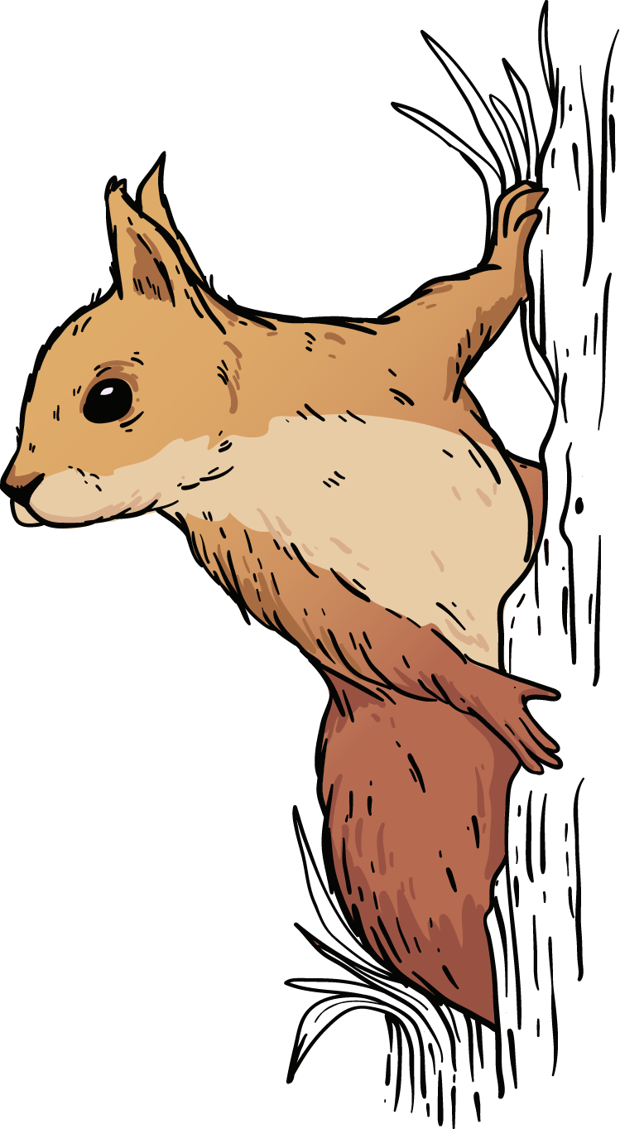
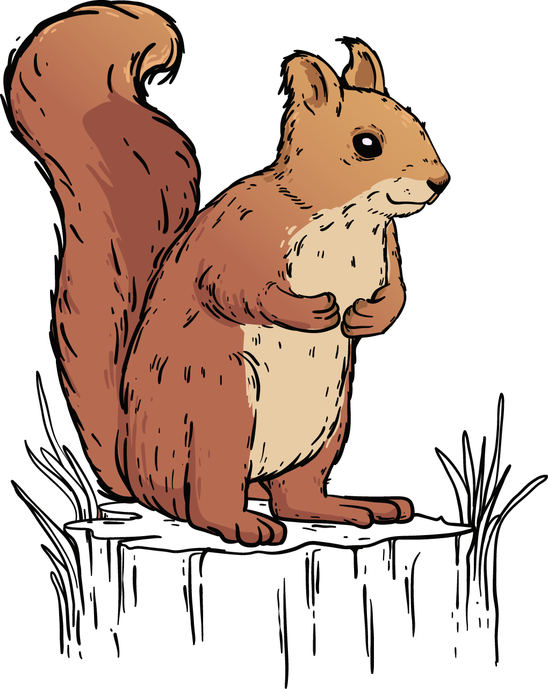
Thank You!
Any questions?

Slide 16
Resources
https://theswiftest.com/animal-rights-index/
https://data.world/makeovermonday/2024week-8-animal-rights

